Slide 1
CS 4530: Fundamentals of Software Engineering Module 1.1 Course Introduction
Adeel Bhutta, Joydeep Mitra and Mitch Wand
Khoury College of Computer Sciences
© 2025 Released under the CC BY-SA license

Slide 2
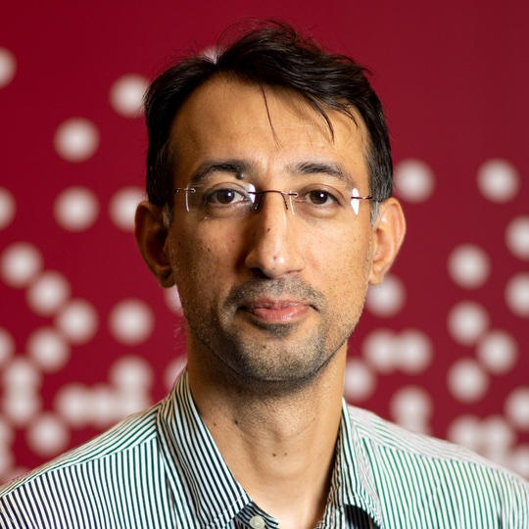
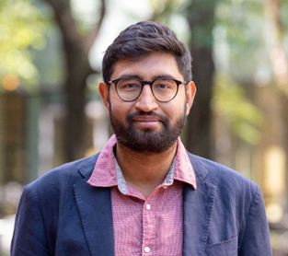
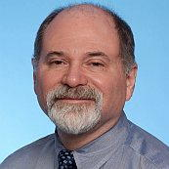
Instructors
Adeel Bhutta
Section 1, 2, 5
Joydeep Mitra
Section 7, 8
Mitch Wand
Section 9

Slide 3
Teaching Assistants
We have around 300 students and 20 teaching assistants.
Their contact info and pictures are on the website
https://neu-se.github.io/CS4530-Fall-2025/staff/

Slide 4
Learning Objectives for this Lesson
By the end of this lesson, you should be able to:
Explain in general terms what software engineering is
List your weekly obligations as a student
List the requirements for completing the course

Slide 5




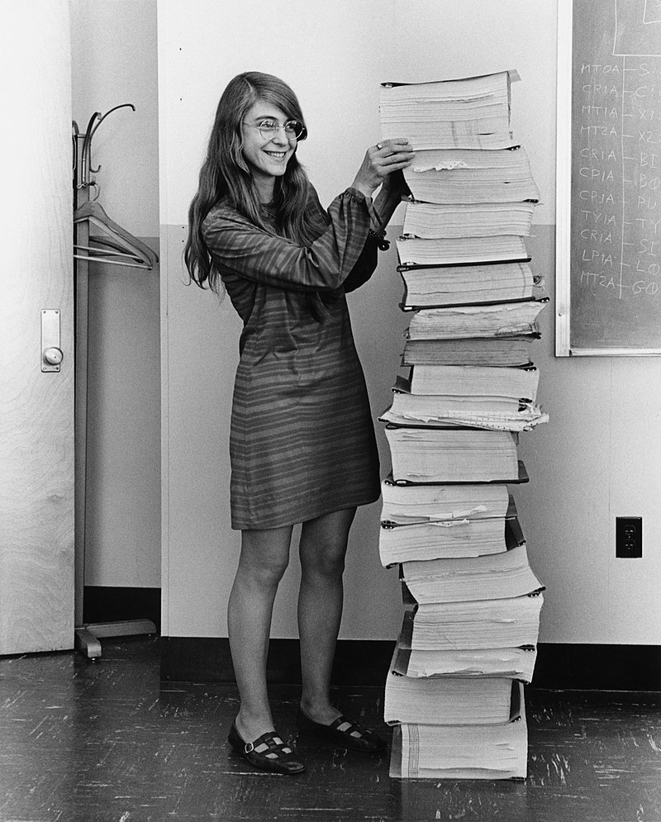
The idea of "software engineering" dates back to 1969
Margaret Hamilton
@ NASA, around 1963
The Apollo Guidance Computer's software
A call to action: We must study how to build software
NATO conference on Software Engineering + Outcomes
Software was very inefficient
Software was of low quality
Software often did not meet requirements
Projects were unmanageable and code difficult to maintain
Software was never delivered
Notes:
If you are interested in history, here is NASA lead software engineer for Apollo program standing next to the code she wrote by hand. This is what took humanity to moon.
Now …
Planning software projects is hard, and in fact, the origin of the term and field software engineering is generally considered to have originated from a 1969 NATO conference, where representatives from member countries described the current “software crisis” - that software was often inefficient, low quality, hard to maintain, and sometimes never delivered. The call to action from this report was to discover methods to build software that were as predictable in quality, cost, and time as, for instance, those used to build bridges in civil engineering.

Slide 6
Goal: to make software an engineering discipline
Can we discover methods to build software that are as predictable in quality, cost, and time as, for instance, those used to build bridges in civil engineering?

Slide 7
Software Engineering encompasses the entire software life cycle
It should apply to the
design,
construction,
and maintenance
=> of large programs
=> over time.
Notes:
Software engineering refers to study of all aspects of software development …. It is an attempt to apply a typical engineering “process” to building of software. We will highlight the approaches that {hopefully} scale well.
Pay attention to design: Design before coding

Slide 8


Okay, what do you mean by "large"?
The Apollo Guidance Computer's software
Almost any pre-series-B startup
Your 4-person project in this class
(image from “The Scale of Space” on KWIT, March 2018)
Notes:
Wildly different notions of scale at work, and from NATO to Google, the practice of software engineering is usually defined by the biggest players!
That doesn’t mean that there aren’t problems that everyone faces.

Slide 9
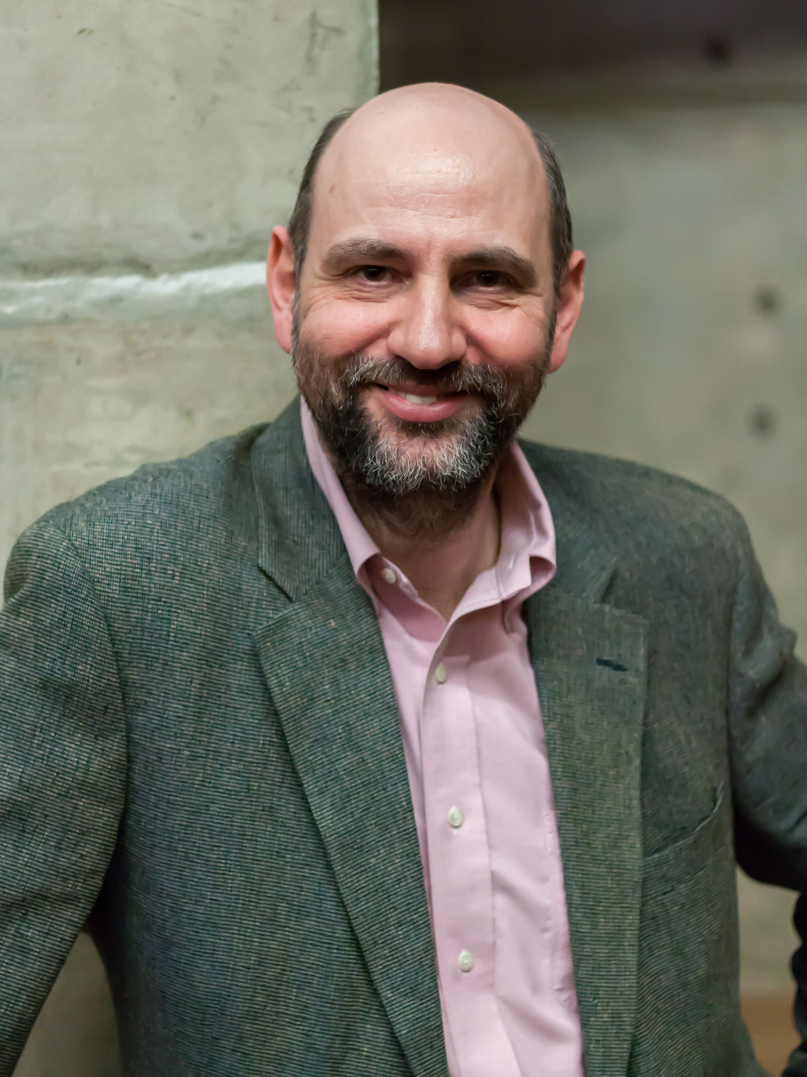
Problem #1: Programs need to be read by people
“Any fool can write code that a computer can understand. Good programmers write code that humans can understand”
- Martin Fowler

Slide 10

Problem #2: People need to talk to each other
“Adding manpower to a late software project makes it later”
Fred Brooks, 1975
Notes:
If you have n people on a project, you have O(n^2) potential connections between them.
In today’s world, we'd say something like "personnel“ hours rather than "man"-power.

Slide 11



So, software engineering must encompass:
Programs,
Processes,
and People

Slide 12
The course will cover
Programs
how to write programs that people can understand and maintain
in a particular domain (medium-sized web application)
Processes
how to divide a large project into engineering tasks
how to coordinate the tasks to form a coherent whole
People
how to organize teams and make them function effectively.

Slide 13
Think of {your software’s} design at three scales
The Planning Scale
key questions: How do we make software artifacts “good”? What does that mean? Who decides?
The Organizational Scale
key questions: What are people’s needs? How do we design software artifacts that meets those needs?
The Implementation Scale
key question: how to design software artifacts that are easy to test, understand, and modify?

Slide 14



So, software engineering must encompass:
PLANNING,
ORGANIZING,
& IMPLEMENTING

Slide 15
So, software engineering must encompass:
PEOPLE
PROCESSES
PROGRAMS
mostly
out
of
scope
PLANNING
ORGANIZING
This class is here-ish
implementing
previous
classes
(OOD)

Slide 16
Learning Objectives for this course:
By the end of this course, you will--
Be able to define and describe the phases of the software engineering lifecycle.
Be able to explain the role of key processes and technologies in modern software development.
Be able to productively apply instances of major tools used in elementary SE tasks.
Design and implement a portfolio-worthy software engineering project in a small team environment that can be showcased to recruiters.
These are normal learning goals for a course at a university!
This is maybe a little different

Slide 17
The course will be delivered through:
In-Class materials / lectures
in-person (most sections) or via zoom (online section)
slides (available on course website)
Practice Activities
these will give you practice with the technologies we will use
we will often start these during class, sometimes in groups
these will be graded
Tutorials
these will give you background on key processes and technologies {we will use}
at a greater level of detail than we can cover in class
much like good blog posts

Slide 18
Course Mechanics: Lectures and Attendance
Classes will include both lectures and in-class activities.
Be sure to bring your laptop
Each instructor will use individual approach to grade the in-class activities.
100% attendance is expected for both on-the-ground and remote sections (especially when working on activities, “work on project” sessions and demos)
For excused absence, please contact the instructor by email.

Slide 19
Course Deliverables
First, an individual project, which we will assign. This is to be done individually.
divided into 2 deliverables (not equally weighted).
this counts for 30% of course grade
Then a group project, done in teams of about 4 people
this counts for 40% of course grade
There will be an exam (worth 20%) on Oct 29 - 31 during Week 9). There will not be a final exam. Check Calendars
Participation / Completion of activities (10%)
Notes:
* Exam is on the first lecture after spring break

Slide 20
Technology
We will use:
TypeScript as implementation language
Jest as Testing Framework
Visual Studio Code as our IDE
React for webapps
GitHub Projects for Project Management
GitHub Actions / Netlify /Heroku / Render for CI/CD
Also, other miscellaneous tools

Slide 21
Projects for You
We will be using Fake StackOverflow as codebase
The individual projects will help you become familiar with the codebase (worth 30% of course grade).
The team project (worth 40%) will be a new feature that you will propose.
Instructors will form the teams with your input.
Further breakdown of team project grade is:
Planning (worth 8% of course grade)
Process (worth 8%)
Product (worth 16%)
Reports (worth 8%)
Peer evaluations (surveys) may be utilized, and individual contributions WILL impact your project grade (between 0-100%).

Slide 22
Grade Appeal Policy
If you have concerns regarding the grading of your work, please let us know right away.
We provide mechanism for you to request regrades for all work submitted
Do not post on Piazza or email your TA or instructor
All regrade requests must be submitted within 7 days from your receipt of the graded work.
If your regrade request is closed and you feel that the response was not satisfactory, you may appeal to the instructor via email within 48 hours

Slide 23
Late Policy
Your work is late if it is not turned in by the deadline.
10% will be deducted for late individual work turned in within 24 hours after the due date
Individual work submitted more than 24 hours late will receive a zero.
If you're worried about being busy around the time of a HW submission, please plan ahead and get started early.
No late submissions allowed for any group work
If you have an accommodation from Disability Access Services (previously DRC), you must request it from the instructors separately for each assignment or exam.
DAS or DRC Accommodations are usually NOT available for Group Assignments (please work with instructor)

Slide 24
Academic Integrity (1)
Students must work individually on all homework assignments.
We encourage you to have high-level discussions with other students in the class about the assignments, however, we require that when you turn in an assignment, it is only your work. That is, copying any part of another student's assignment is strictly prohibited.
If you steal someone else's work, you fail the class.
You are responsible for protecting your work. If someone uses your work, with or without your permission, you fail the class.

Slide 25
Academic Integrity (2)
For Individual Projects and Activities.
The use of auto-complete tools is permitted
Use of Generative AI (eg Chat GPT, Claude, etc.) is prohibited
You may use LLM based AI tools like search engines, but you can never copy-paste code.
For final projects
Use of AI tools is permitted as long as you understand what was submitted.
Use of ‘vibe’ coding is strongly discouraged
We reserve the right to “interview” you to gauge your understanding (with possible grade adjustments)
Notes:
<see a detailed version of this policy on course website>

Slide 26
Academic Integrity (3)
If you are concerned that by reusing and attributing that copied code it may appear that you didn't complete the assignment yourself, then please raise a discussion with the instructor.
If you are in doubt whether using others' work is allowed, you should assume that it is NOT allowed unless the instructors confirm otherwise.

Slide 27
Communication
Course web page (https://neu-se.github.io/CS4530-Fall-2025)
Canvas will mirror the course web site.
Assignments, important notices, etc., will appear in both places.
Piazza (see Canvas for link)
Questions about content, policies, assignments, projects, etc. are better asked on Piazza, so everybody gets the same answers.
Contacting the Instructor
For private questions about your individual situation, please email the instructor directly (do NOT use Canvas messages – sometimes they do not get through to the instructors)
Please put CS4530 in the subject line so your message does not get overlooked
We encourage all students to “meet” with the instructor at least once!
Office Hours
Schedule is available at (https://neu-se.github.io/CS4530-Fall-2025/staff/)
TA Office Hours are held via Khoury Office Hours App

Slide 28
Review
Now that you've studied this lesson, you should be able to:
Explain in general terms what software engineering is
List your weekly obligations as a student
List the requirements for completing the course
Notes:
Lesson 1.1 Activity: Introductions Activity 1: Introduce yourself and ask students to introduce themselves
Activity 2 {Optional}: Welcome Survey. Then discuss survey responses and answer questions

